Slide 1
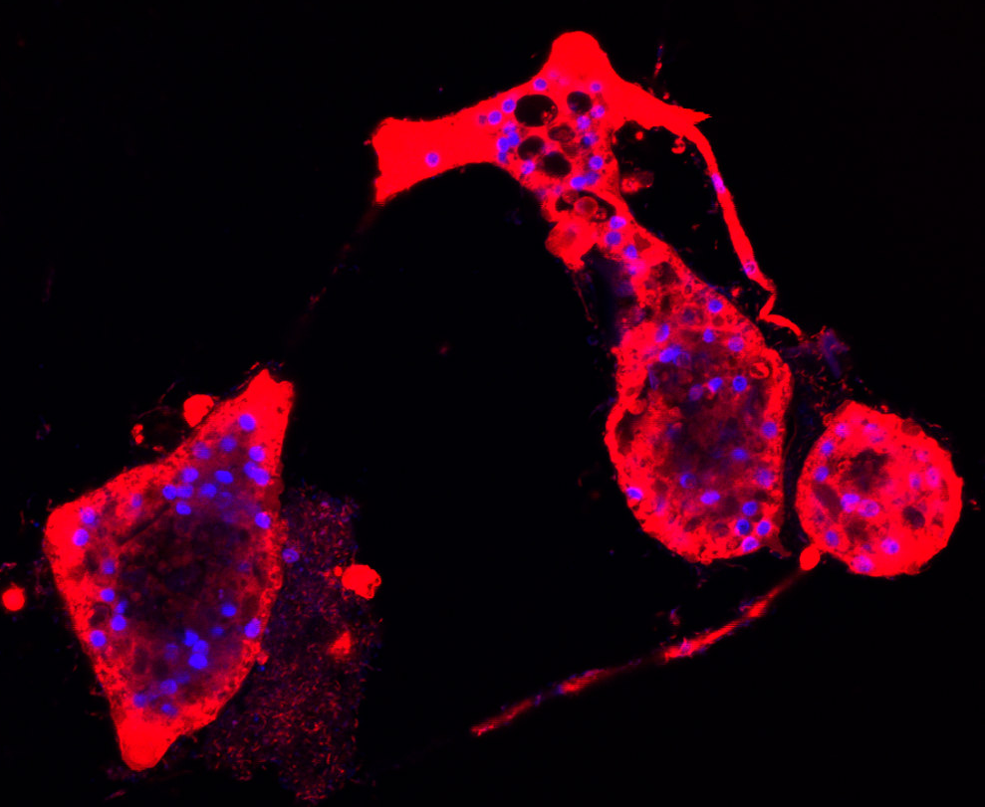
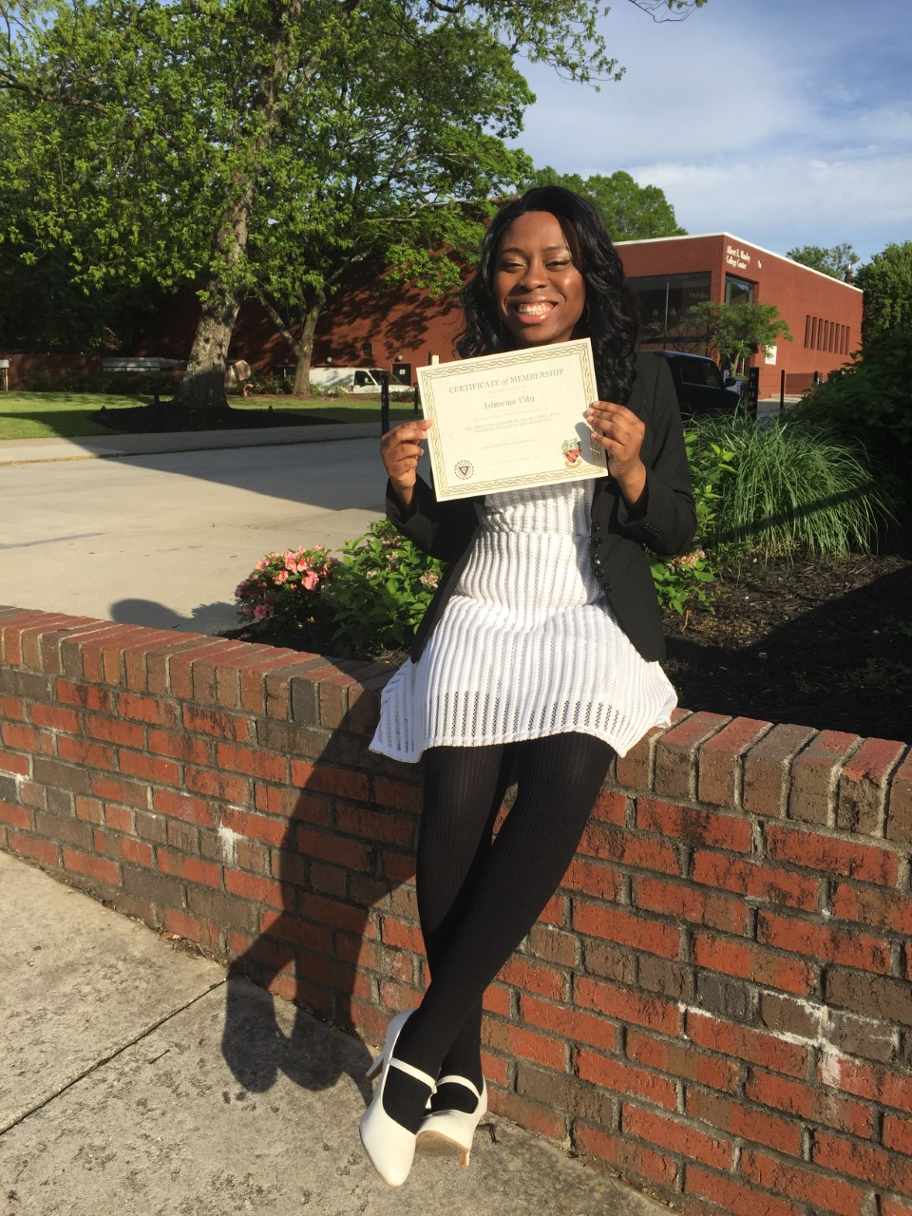

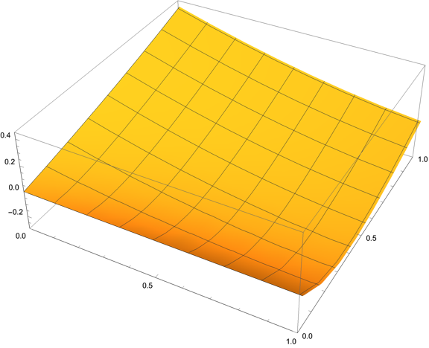
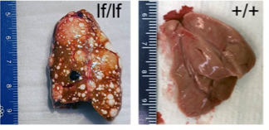
Dr. Yonas Tekle [Spelman] - Trichosphaerium amoeba
Fitness
Level of Parental Care
Baseline Egg Death Rate
Dr. Longhua Guo [UCLA] - Lemon frost gecko
Dr. Hope Klug [UTC] - Evolutionary Loss of Parental Care
Notes:
Introduce yourself and what research you did in the past
For introduction – when talking out loud, say one SHORT sentence about your research (ex: amoebas (click), leopard geckos(click) and parental care(click)

Slide 2

Objective: Build my quantitative and computing skills
Doing a masters in Medical Informatics
Notes:
Here to build up my mathematical modelling and computer skills – I’ll be doing a medical informatics master’s program at Dartmouth
Improvement of doctor to patient relationship – management and analysis of patient data
My personal research interests - Evolution and cells – maybe modelling cell motility (?) – but I hope to acquire much knowledge

Slide 3
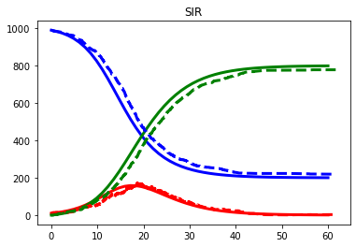
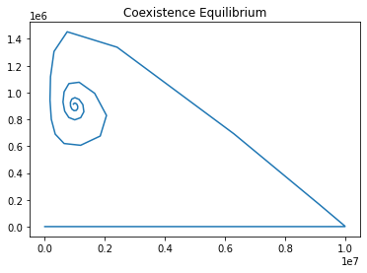
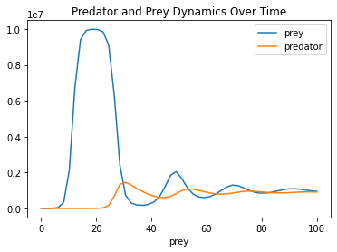
Biological Simulations through Mathematical Modelling
SIR models
Lotka Volterra
Notes:
What have you done these past weeks?
- Simulated models including SIR and Lotka
- We can just say out loud we studied the coexistence equilibrium

Slide 4
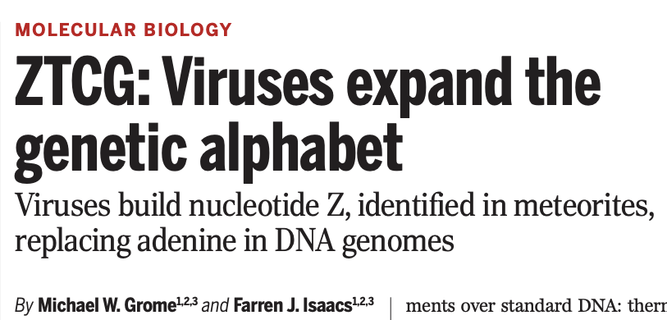
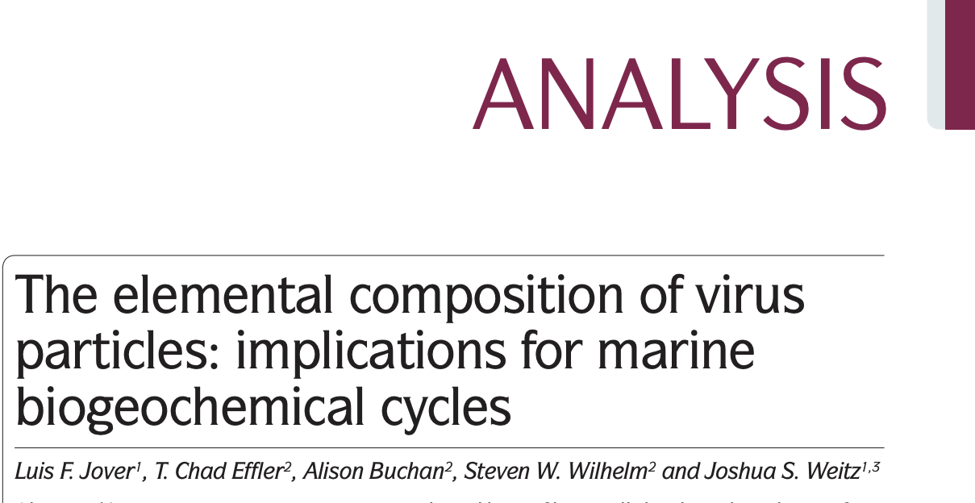
Bioinformatic Analysis of Viral Elemental Content
How does Z substitution effect cyanophage elemental content?
CNP Ratio:
Cyanophage S-2L (w/A):
Cyanophage S-2L (w/Z):
9.32 : 3.87 : 1.00
9.32 : 4.02 : 1.00
Notes:
Order it
1. Cyanophage paper - samples from a
2. Next click the Jover paper and this led us to the quwario
3. How does the Z substitiuon change the stoichometry – put the answer
4. Then go to the Mende, well we saw adaptations with microbacteria, so what about viruses?

Slide 5
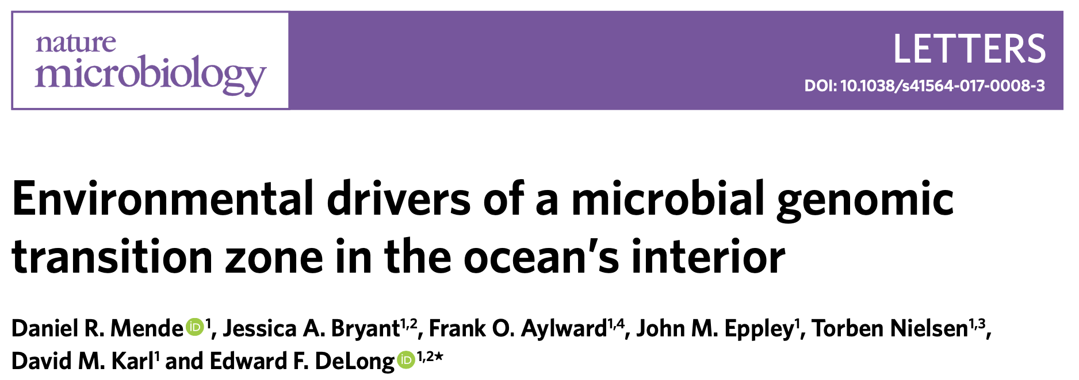
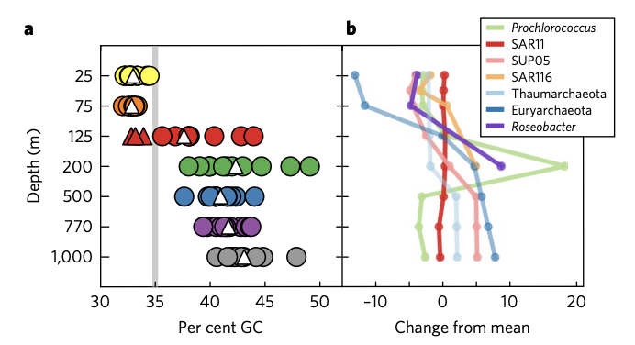
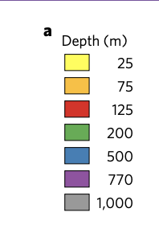
Do viral genomes adapt to host nitrogen limitation?
Collect viral genomes
Calculate the N content
Map genomes to the nutrient conditions
Hypothesis:
Virus genomes will have less nitrogen (and lower GC content) in environments with less nitrogen
Notes:
Make it have two texts where it is this, another click, and briefly (sentence fragment) describes the concept for the actual study
When talking describe what you’re going to do (find genomes, study nitrogen content, and compare nutrient environments where they were isolated from)
Got started this week, so I’m still in this stage
This work has implications on the C:N ratios of viral lysate, which is an important consideration for refining our understanding of the Earth’s carbon cycle in the face of climate change.

Slide 6

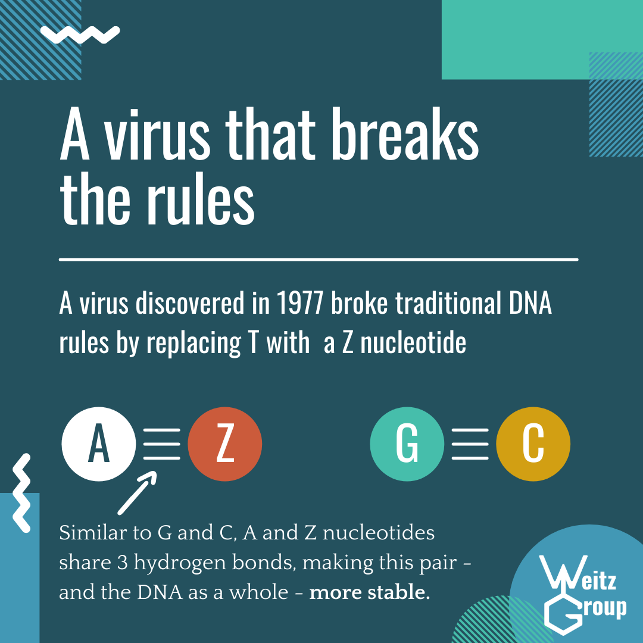
Weekly paper summary series of current research in viral ecology and oceanography
Notes:
Great slide to END on
When describing it out loud, we read the paper and we’ve been working on this side project involving these summaries and Audra has been working on this

